Slide 1

Basic Details of the Team and Problem Statement
Ministry/Organization Name/Student Innovation:
PS Code: 1475
Problem Statement Title: Student Innovation
Team Name: SOS Tech
Team Leader Name: Dhuruv Swamy R
Institute Code (AISHE): U-0460
Institute Name: Karunya Institute of Technology and Sciences
Theme Name: Robotics and Drones

Slide 2
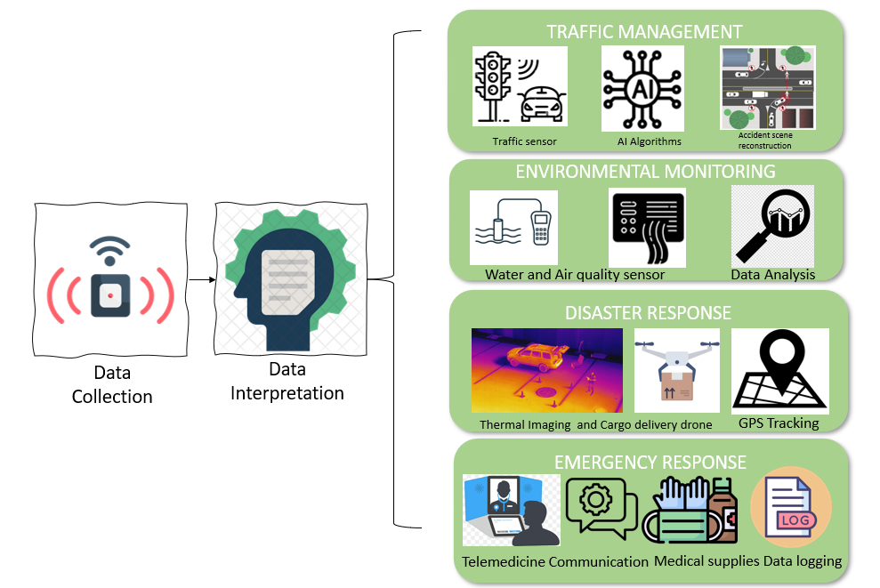
Idea/Approach Details
Idea/Solution/Prototype :
The "RescueTech System" is an innovative and adaptable technology solution designed to address critical challenges in India, spanning emergency response, traffic management, environmental monitoring, and medical emergencies.
This comprehensive system employs a versatile modular robotic and drone platform with the capability to transform into specialized modules, making it remarkably flexible and adaptable.
KEY POINTS:
Modular Robotic Platform: Highly flexible and adaptable, the system addresses India's urgent needs in emergency response, traffic control, and environmental surveillance by swiftly configuring specialized modules as required.
Medical Emergency Assistance: Beyond its core functions, the system deploys specialized drones for rapid healthcare crisis responses, reinforcing India's safety infrastructure and well-being.
TECHNOLOGICAL STACK:
Modular Robotics and Drones
Sensors
Artificial Intelligence (AI)
Communication Infrastructure
Mapping and Geographic Information Systems (GIS)
Data Analytics Platforms
Mobile Apps and User Interfaces
Cloud Infrastructure
Security Protocols
Power Management

Slide 3
Idea/Approach Details
Use Cases
Dependencies / Show stopper
Emergency Response: Rapid deployment of drones for search and rescue operations, providing real-time situational awareness and assistance during disasters.
Traffic Management: Monitoring and controlling traffic flow to reduce congestion and improve road safety.
Environmental Monitoring: Assessing air and water quality, detecting pollution sources, and providing data for informed environmental policies.
Medical Emergencies: Dispatching medical emergency drones to deliver critical supplies, conduct remote medical assessments, and facilitate swift responses to healthcare crises.
Disaster Response: Deploying specialized modules to handle disaster scenarios, such as fire-fighting drones and flood monitoring.
Regulatory Approvals: Mandatory compliance with aviation and medical regulations based on the application.
Infrastructure: Challenges in establishing remote charging stations and communication infrastructure.
Integration Challenges: Ensuring seamless hardware and software integration is crucial.
Cost Management: Significant development costs require funding and support.
Scalability: Expanding coverage demands substantial resources and logistical planning.
Data Security: Robust cybersecurity is vital for safeguarding sensitive mission data.
Maintenance and Training: Ensuring the proper maintenance of the system's hardware and ongoing training for operators and emergency responders could be critical for its long-term success.
Public Acceptance and Trust: Gaining the trust and acceptance of the public and relevant authorities for such advanced technology in critical areas like healthcare and emergency response may require community engagement and awareness efforts.

Slide 4
Team Member Details
Team Leader Name: DHURUV SWAMY R
Branch (B.tech): AI & DS Stream : CSE Year (I,II,III,IV): II
Team Member 1 Name: BHARATH KUMAR S
Branch (B.tech): AI & DS Stream : CSE Year (I,II,III,IV): II
Team Member 2 Name: HARIHARAN
Branch (B.tech): AI & DS Stream : CSE Year (I,II,III,IV): II
Team Member 3 Name: SAROJ SWADITHYA M
Branch (B.tech): CSE (AI) Stream : CSE Year (I,II,III,IV): II
Team Member 4 Name: V JASWANTHINI
Branch (B.tech): CSE (AI) Stream : CSE Year (I,II,III,IV): II
Team Member 5 Name: P CELCIA
Branch (B.tech): AI & DS Stream : CSE Year (I,II,III,IV): II

